Slide 1
User
First name
Last name
Id
Birthday
Authorization
Password
Phone
Gender
Branch (The store)
Message
Title
Content
Link
Created Date
Daily Briefing
Title
File Name
Minhal
Title
File Name
Job
Title
Salary
Guidance
Title
File Name
Link
Title
Link

Slide 2

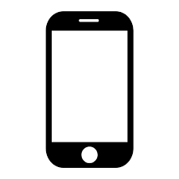
Android or
IOS App.
(React Native)
Office website
(React.js)
Server
(Node.js)
Mongo
DB

Slide 3
User
View
Server
DB
Type user and password
Click login
Sending a login request with user and password in the body
Seraching for a user with the given id and password in the DB
No user was found
Printing an invalid user error to the screen
Returning an error to the client
Creating a token and sending it to the user
A user was found
Saving the token in the cache and moving to the main screen
Saving the token to the DB for the given user
User
View
Server
DB

Slide 4
User
View
Server
DB
Making an action that requires getting a model
Sending a request to the server for getting the wanted model
Checking the token. Only if the user has an authentication for getting the model getting the model from the DB
If user has the required authentication, getting the model/models
Shows the wanted screen with the models if no error occurred
Returning a response with the wanted model/models
If user has the required authentication returning an error
Sending a response with unauthorized error to the client
Shows the unauthorized error to the user.
User
View
Server
DB

Slide 5
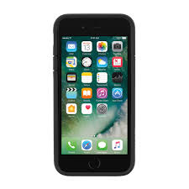


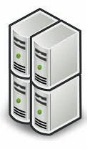

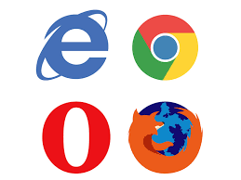


Slide 6

Team: Idan Lazar, Yonatan Ben Avraham, Ronel Shemtov, Ori Litman, Yuval David
Supervisor: Eliav Menachi

